Slide 1
CS 513 KDD
Job Change Prediction
Guided By: Prof. Khasha Dehnad
Team Members:
Archana Kalburgi: 10469491
Arya Guddemane Vishwakumar: 10459529
Dhruv Solanki: 10459272
Rohit Pradhan: 10468609

Slide 2
Agenda
Problem Statement
Dataset
Data Pre-Processing
Exploratory Data Analysis
Machine Learning Models
Model Evaluation
Conclusion

Slide 3
Problem Statement
A company which is active in Data Science wants to hire people. They want to know which of these are potential candidates.
We need to explore the features which will help the company to categorize candidates.
We shall be using analytical approach to determine potential candidates.

Slide 4
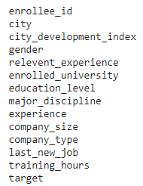
Dataset
Dataset contains nearly 19k rows and 14 columns and is gathered from Kaggle.
Data has information about various features to make concrete decision on whether a person will leave or continue current job.
The task is to predict if an employee will look for job change.

Slide 5
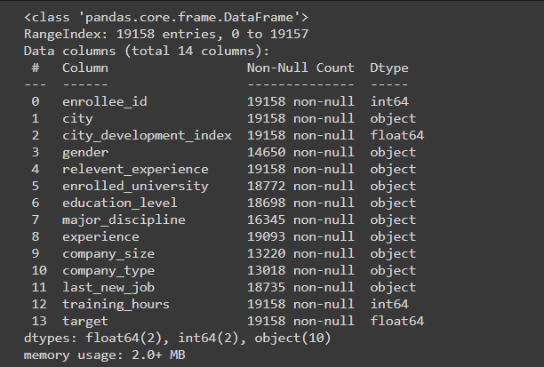
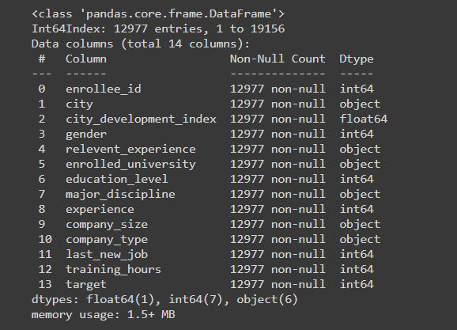
Exploratory Data Analysis
Basic Information about the dataset
Data before Pre-processing
Data after Pre-processing
Total number of rows: 19158
Total number of columns: 14
Total number of rows: 12977
Total number of columns: 14

Slide 6
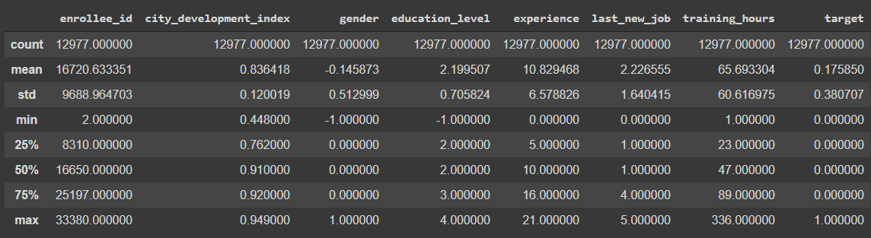
Exploratory Data Analysis
Summary of the dataset after cleaning

Slide 7
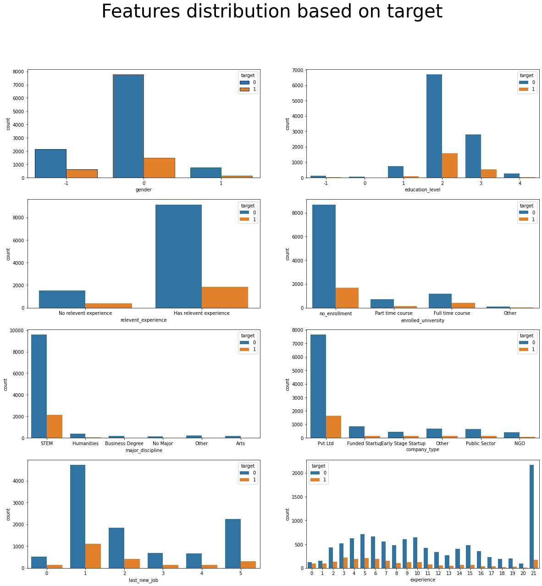
Exploratory Data Analysis - Bivariate
Feature Distribution based on Target

Slide 8
Exploratory Data Analysis - Bivariate
Feature Distribution based on Target

Slide 9
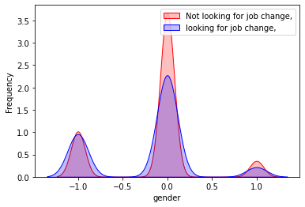
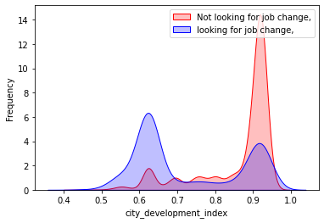
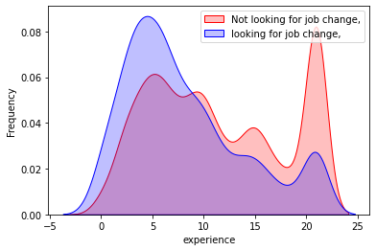
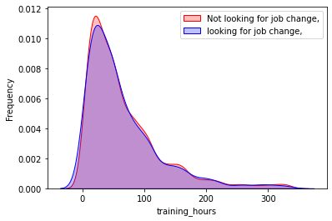
Kernel Density Estimate Plot

Slide 10
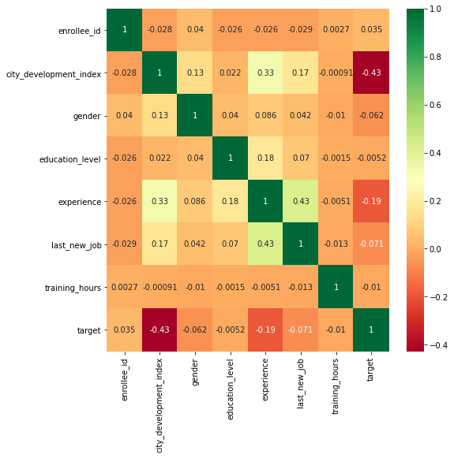
Correlation between features

Slide 11
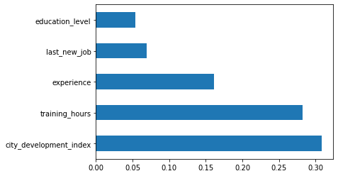
Further steps include:
Label Encoding the necessary columns
Dropping insignificant features
Splitting of data to Inputs and Output
Standardization of data
Finding best 5 features

Slide 12
Classification Algorithms
K Nearest Neighbor Classifier
Naive Bayes
Decision Tree Classifier
Random Forest Classifier
Artificial Neural Network

Slide 13
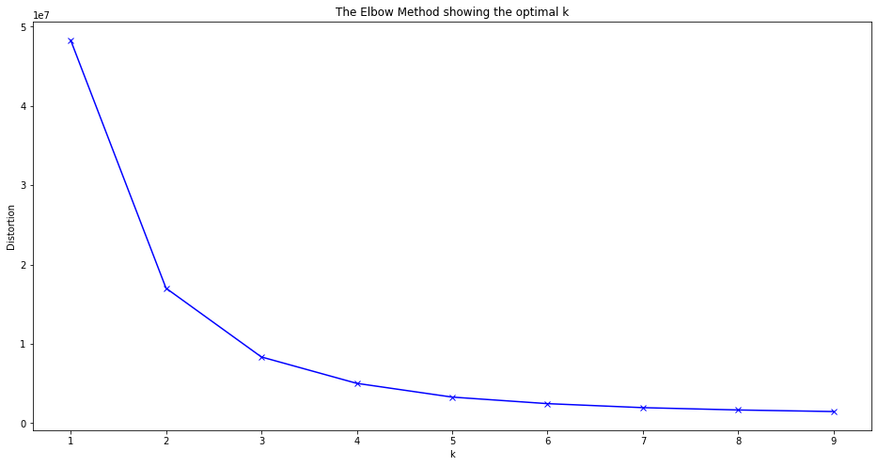

Elbow Method to find optimal k
With 12 features in consideration
With 5 features in consideration

Slide 14
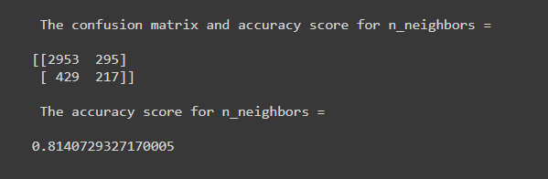
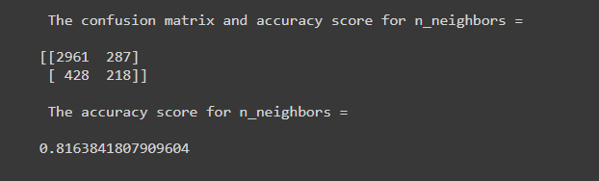
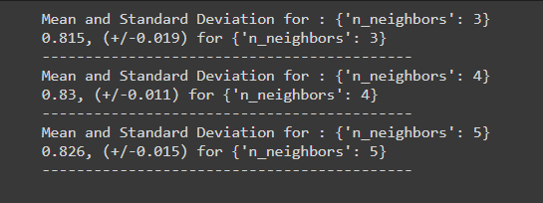
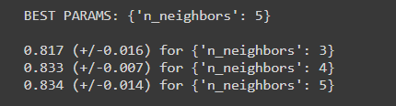
K Nearest Neighbors Algorithm
Accuracy: 12 features in consideration
Accuracy: 5 features in consideration
Best Parameter: 12 features in consideration
Best Parameter: 5 features in consideration

Slide 15
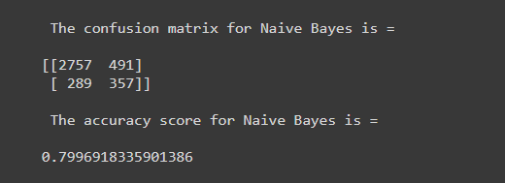
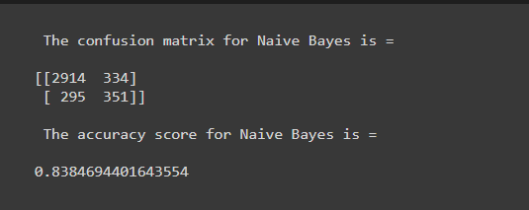
Naive Bayes Algorithm
Accuracy: 12 features in consideration
Accuracy: 5 features in consideration

Slide 16
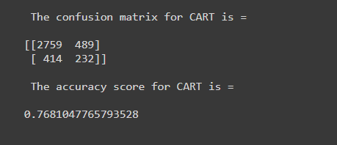
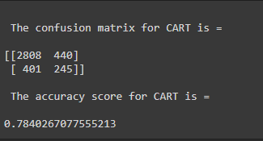
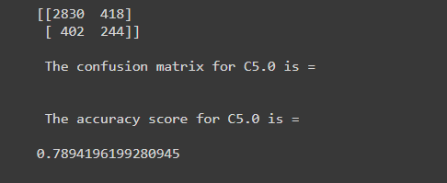
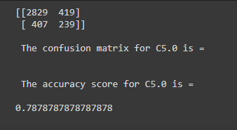
Decision Tree Classifier
CART
Accuracy: 12 features in consideration
Accuracy: 5 features in consideration
C 5.0
Accuracy: 12 features in consideration
Accuracy: 5 features in consideration

Slide 17
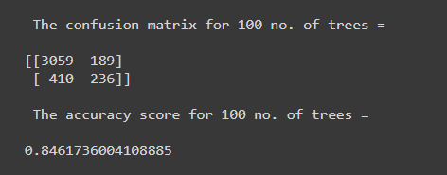
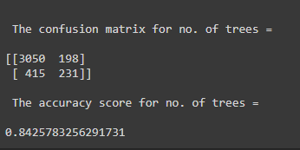
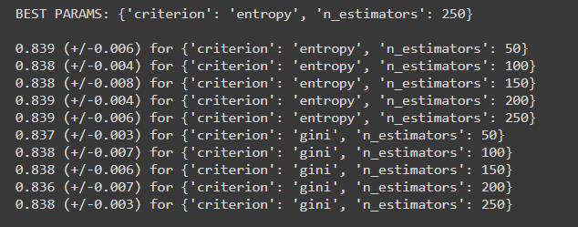
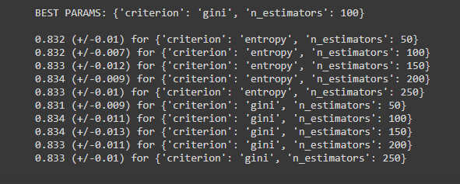
Random Forest Classifier
Accuracy: 12 features in consideration
Accuracy: 5 features in consideration
Best Parameter: 12 features in consideration
Best Parameter: 5 features in consideration

Slide 18
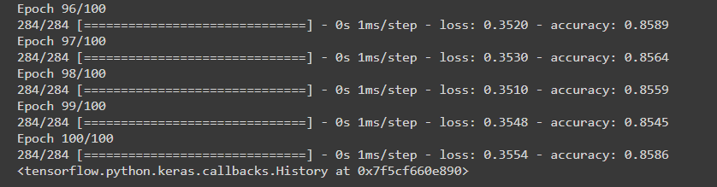
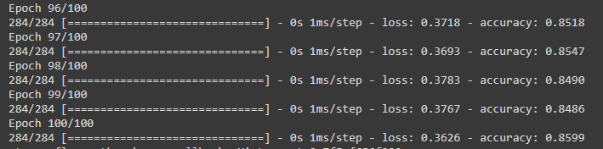
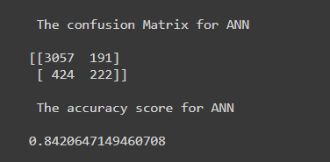
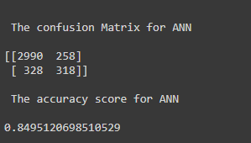
Artificial Neural Network
Last few epochs
12 features in consideration
5 features in consideration
Accuracy: 12 features in consideration
Accuracy: 5 features in consideration

Slide 19
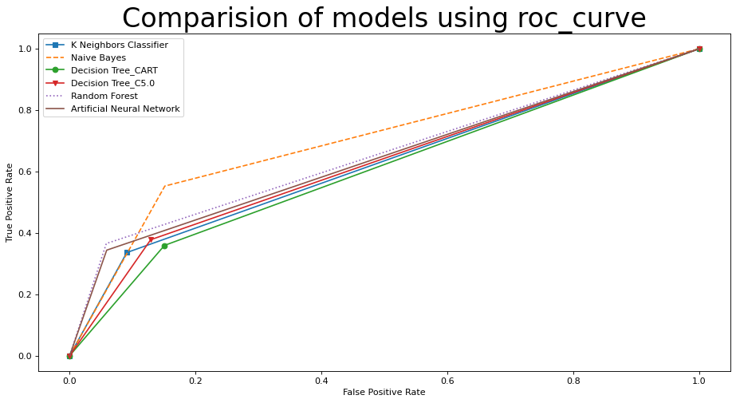
Comparison of models using ROC curve
12 features in consideration

Slide 20
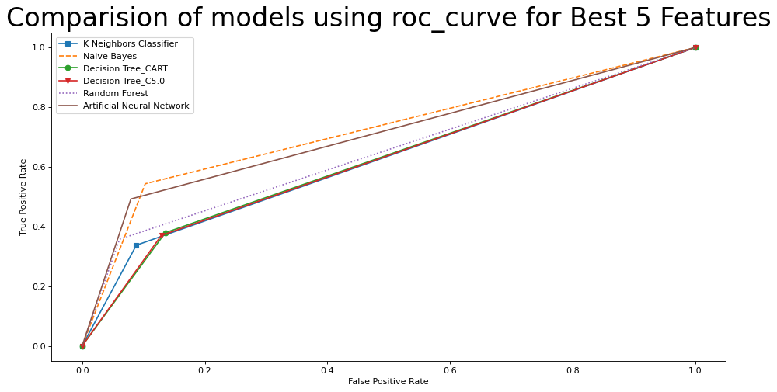
Comparison of models using ROC curve
Best 5 features in consideration

Slide 21
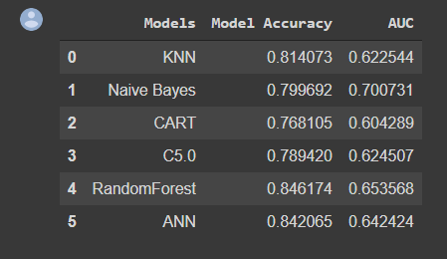
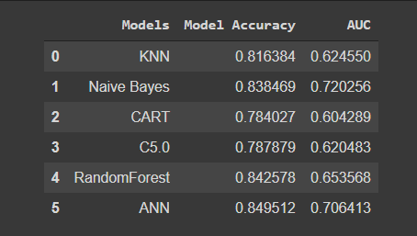
Comparison of models by their accuracy and AUC
12 features in consideration
5 features in consideration

Slide 22
Testing the model by using test data
Test data contains 2129 rows and 13 columns
Data Pre-processing is carried out on test data same way it was done to train data.
Final number of rows that is being used to test the model is 1019 and 5 best features.
1. City_developement_index.
2.Education Level.
3.Experience.
4.Last_new_job.
5. Training_hours.

Slide 23
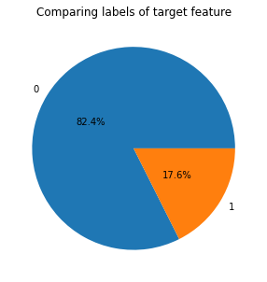
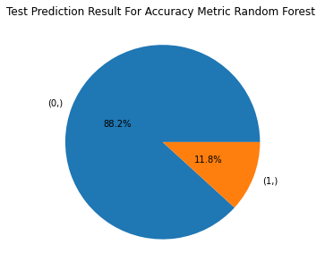
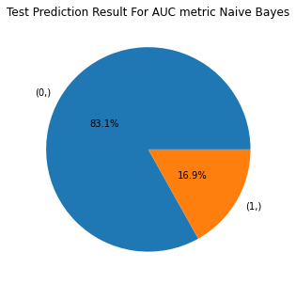
Analysis of results
0 - Not looking for Job Change
1 - Looking for Job Change
Train data-

Slide 24
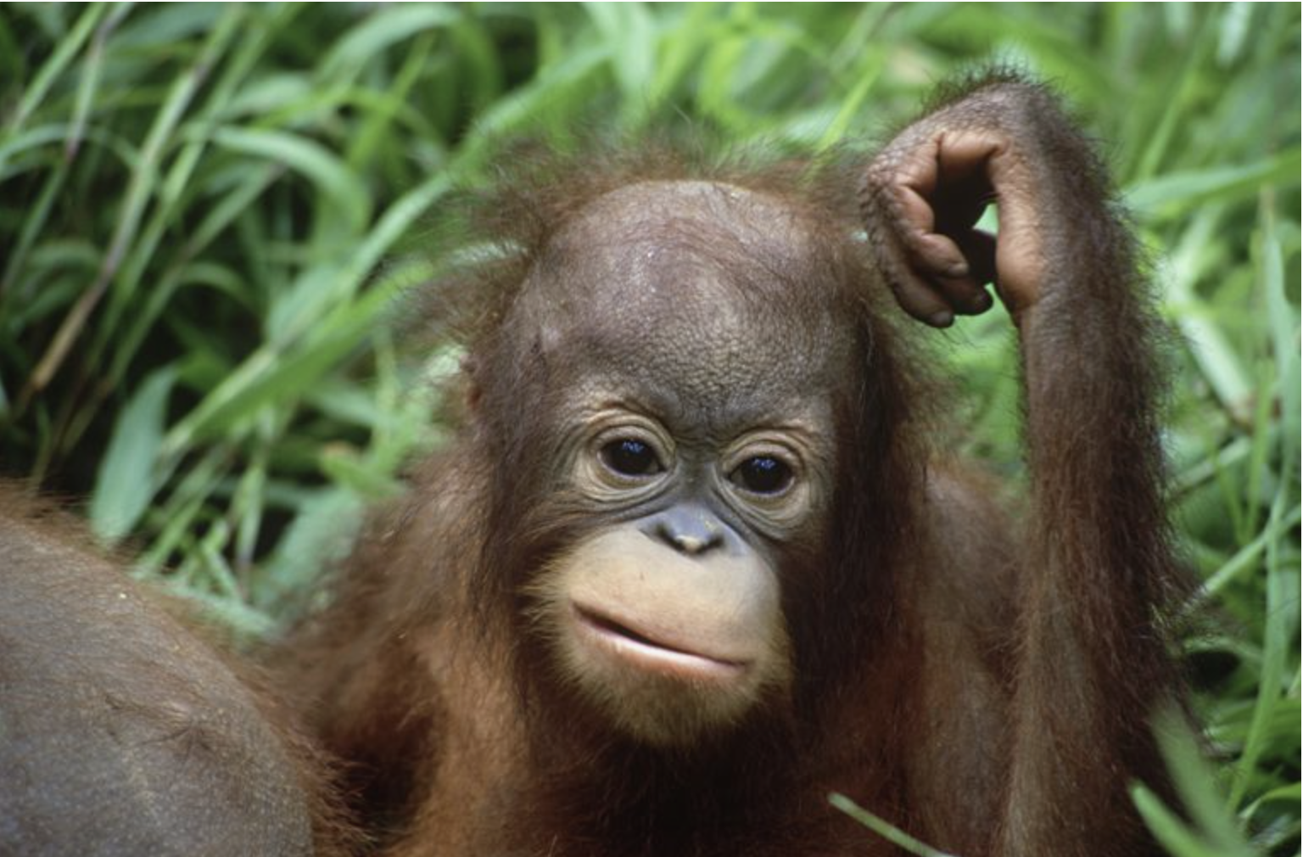
Ok but, which model to choose?

Slide 25
Conclusion
Based on accuracy as evaluation metric Random Forest Classifier performs best.
Based on ROC/AUC as evaluation metric Naive Bayes is the ideal model for prediction.

Slide 26
Thank you!
Any questions?

